Slide 1
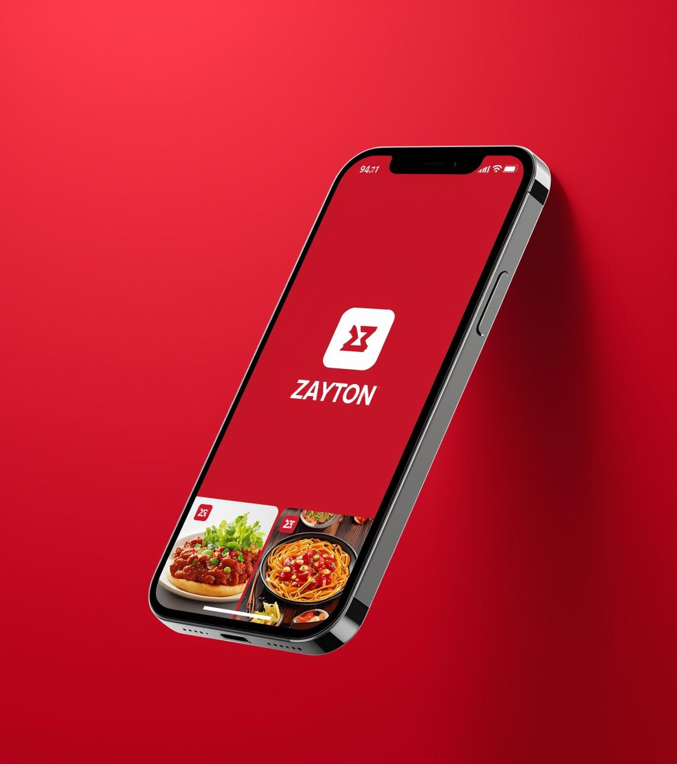
Zayton Food Delivery App
Your Favorite Meals, Delivered Fast
Presented by [Your Name Here]

Slide 2
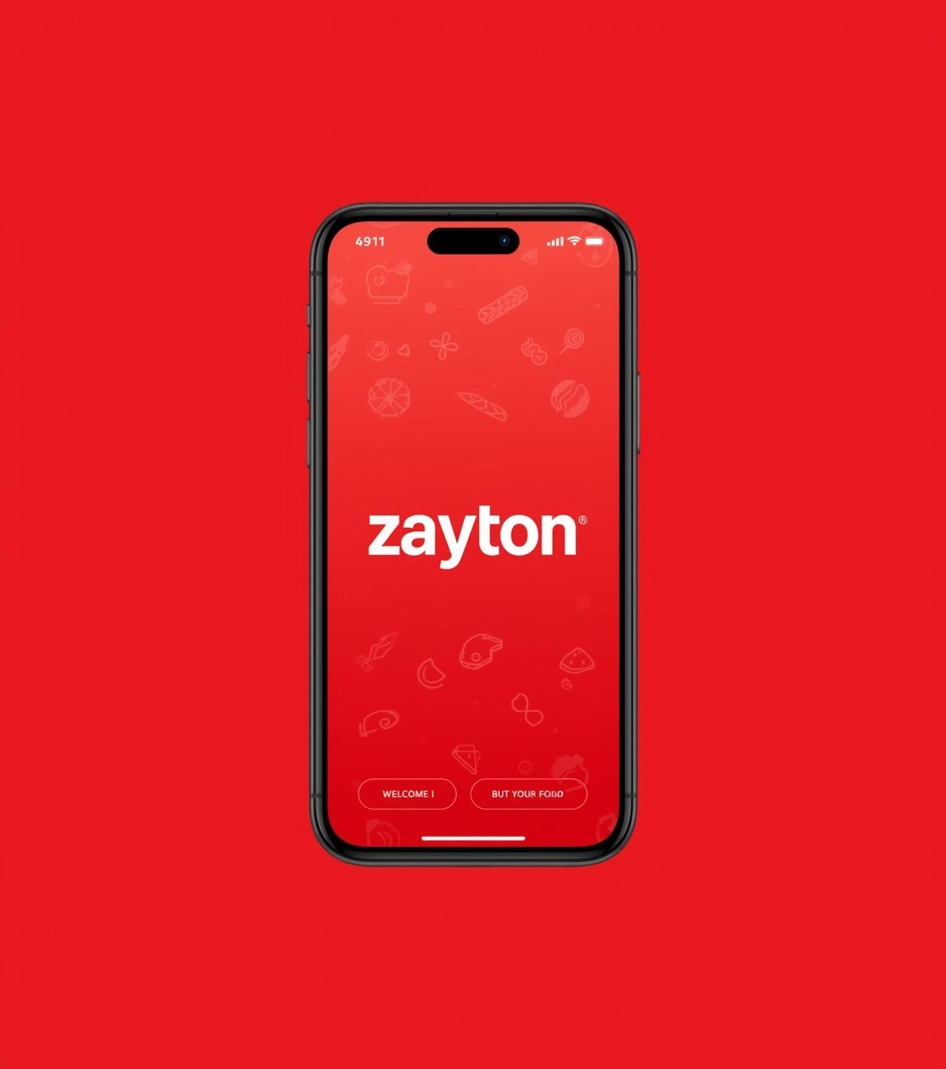
Welcome Screen
Welcome to Zayton – Your Favorite Meals, Delivered Fast. The app’s clean and inviting design creates an engaging experience from the moment you open it, featuring our logo and a vibrant background that sets the tone for delicious meal exploration.

Slide 3
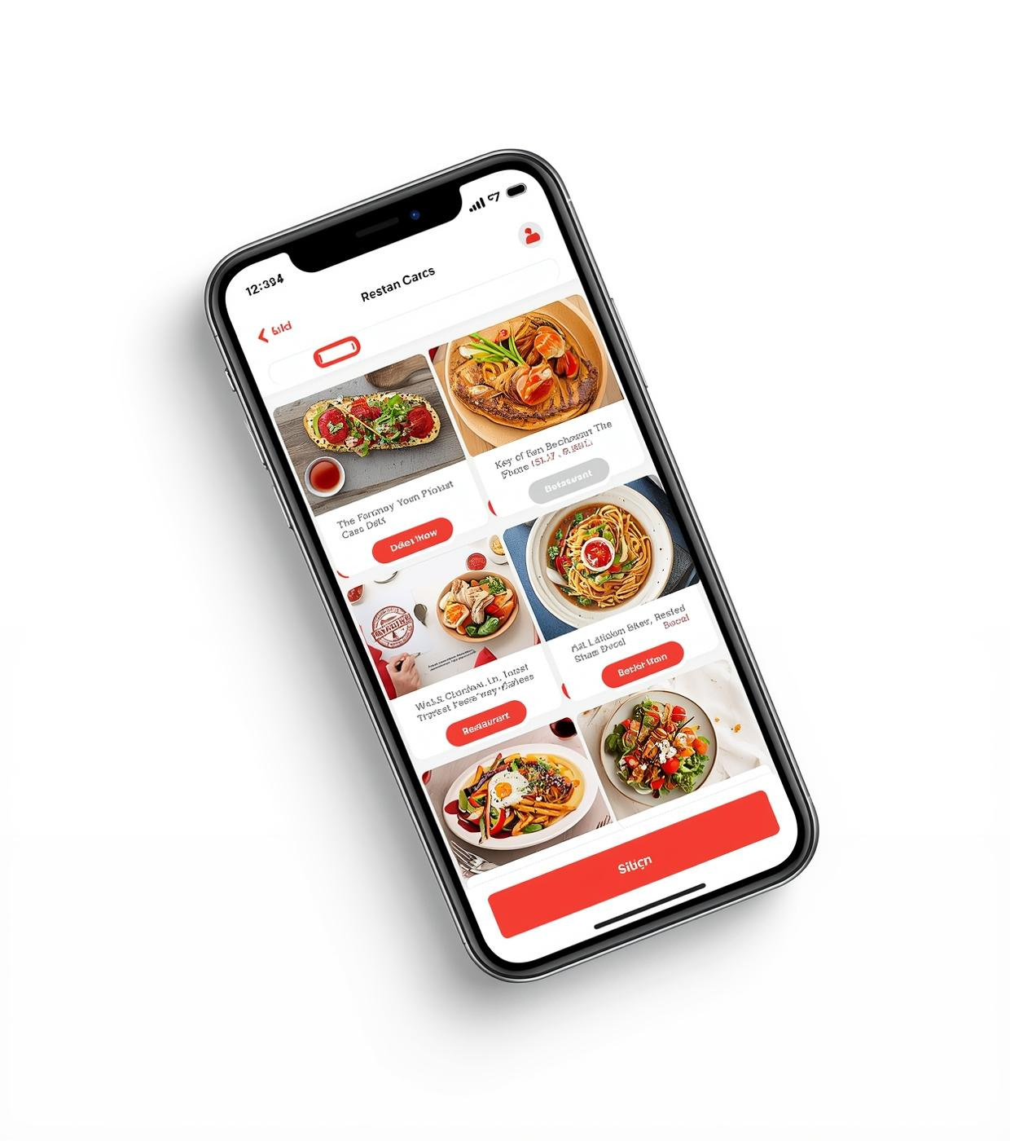
Browse Restaurants
Discover top local restaurants with our user-friendly interface, showcasing appetizing food images and quick access to menus. Enjoy a smooth browsing experience as you explore your favorite meals right from your iPhone 17.

Slide 4
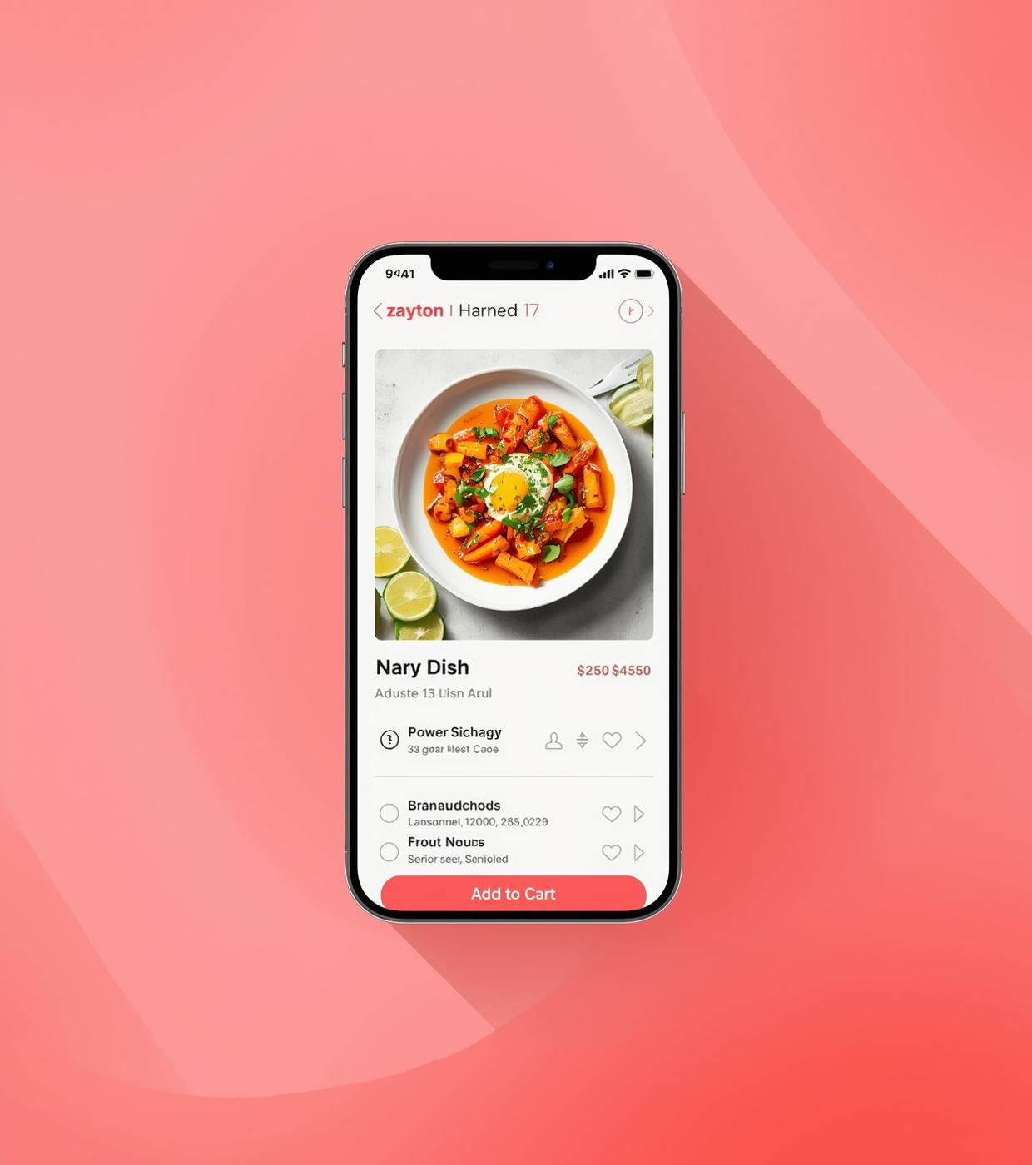
Menu & Food Details
Explore a variety of delectable menu options and easily customize your order to suit your taste. The Zayton app empowers you to select ingredients, portion sizes, and extras for a tailored dining experience.

Slide 5
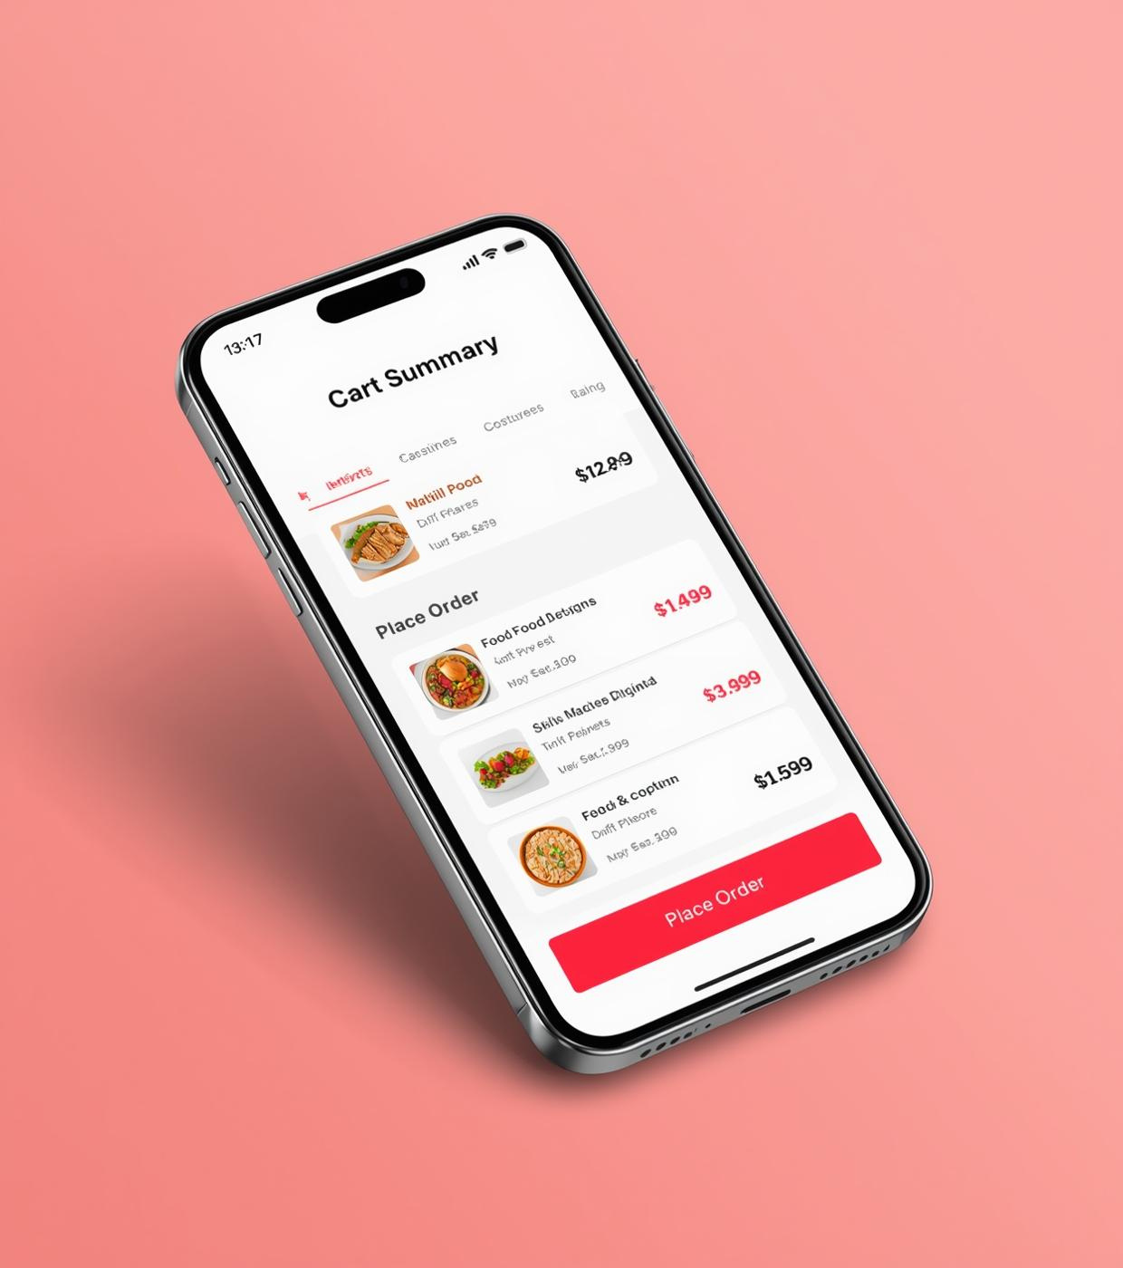
Cart & Checkout
Experience a streamlined and secure checkout process with Zayton. View your cart summary, total price, and enjoy the convenience of a simple payment flow designed to keep your transactions safe and efficient.

Slide 6
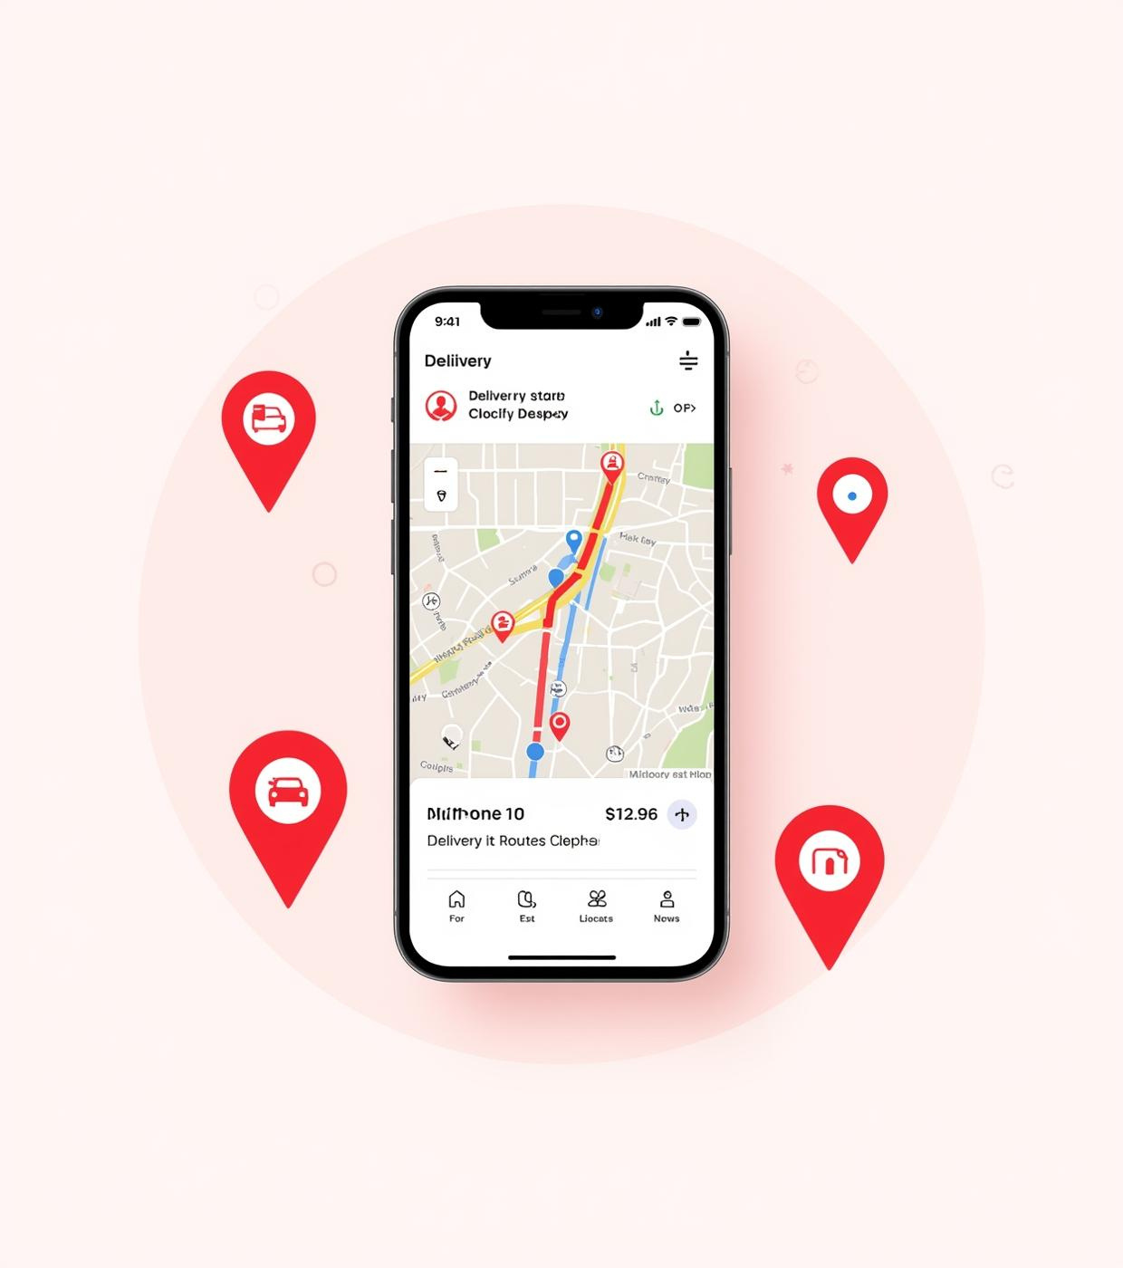
Order Tracking
Stay updated with real-time order tracking and delivery route visibility. Zayton ensures you know exactly when your favorite meals are on their way, enhancing your dining experience with transparency and engagement.

Slide 7
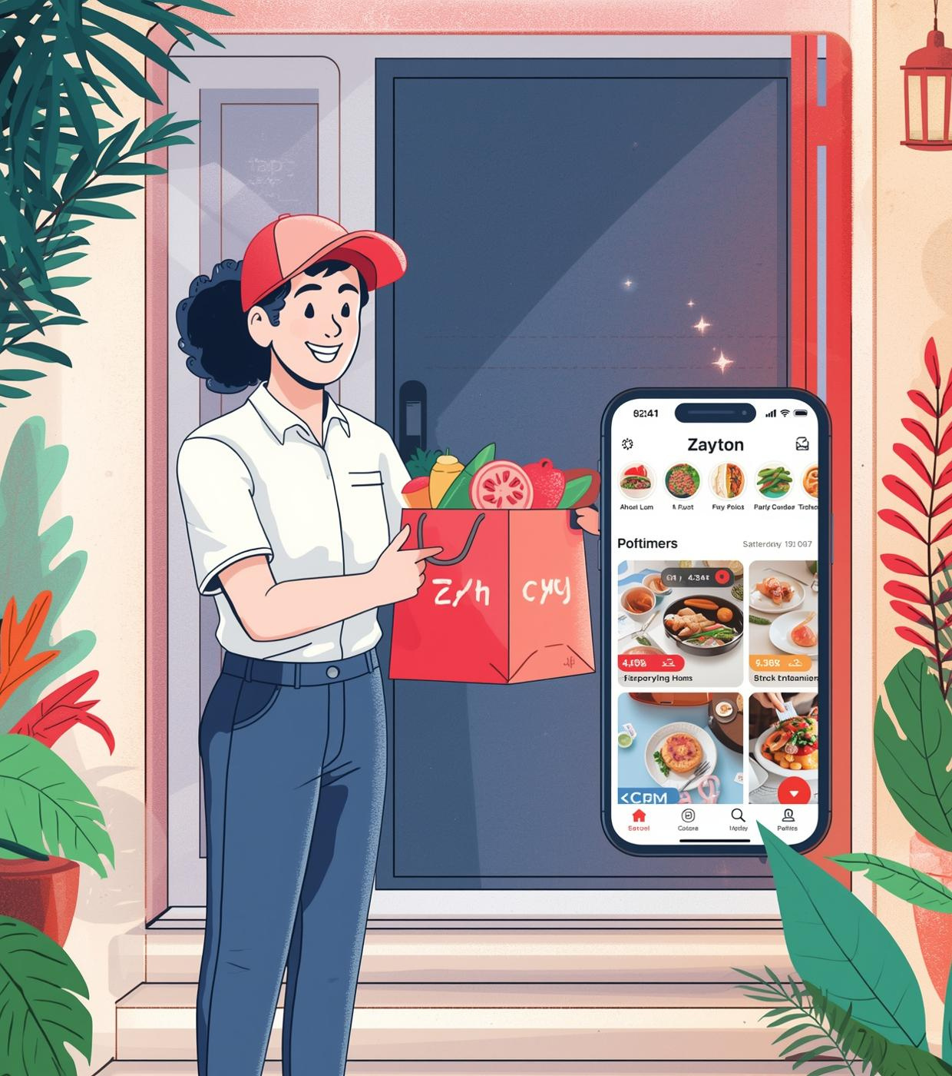
Delivery Confirmation
Celebrate the joy of receiving your order with Zayton! Our delivery personnel ensure a friendly, seamless experience while bringing your favorite meals directly to your doorstep, enhancing your satisfaction with every delivery moment.

Slide 8
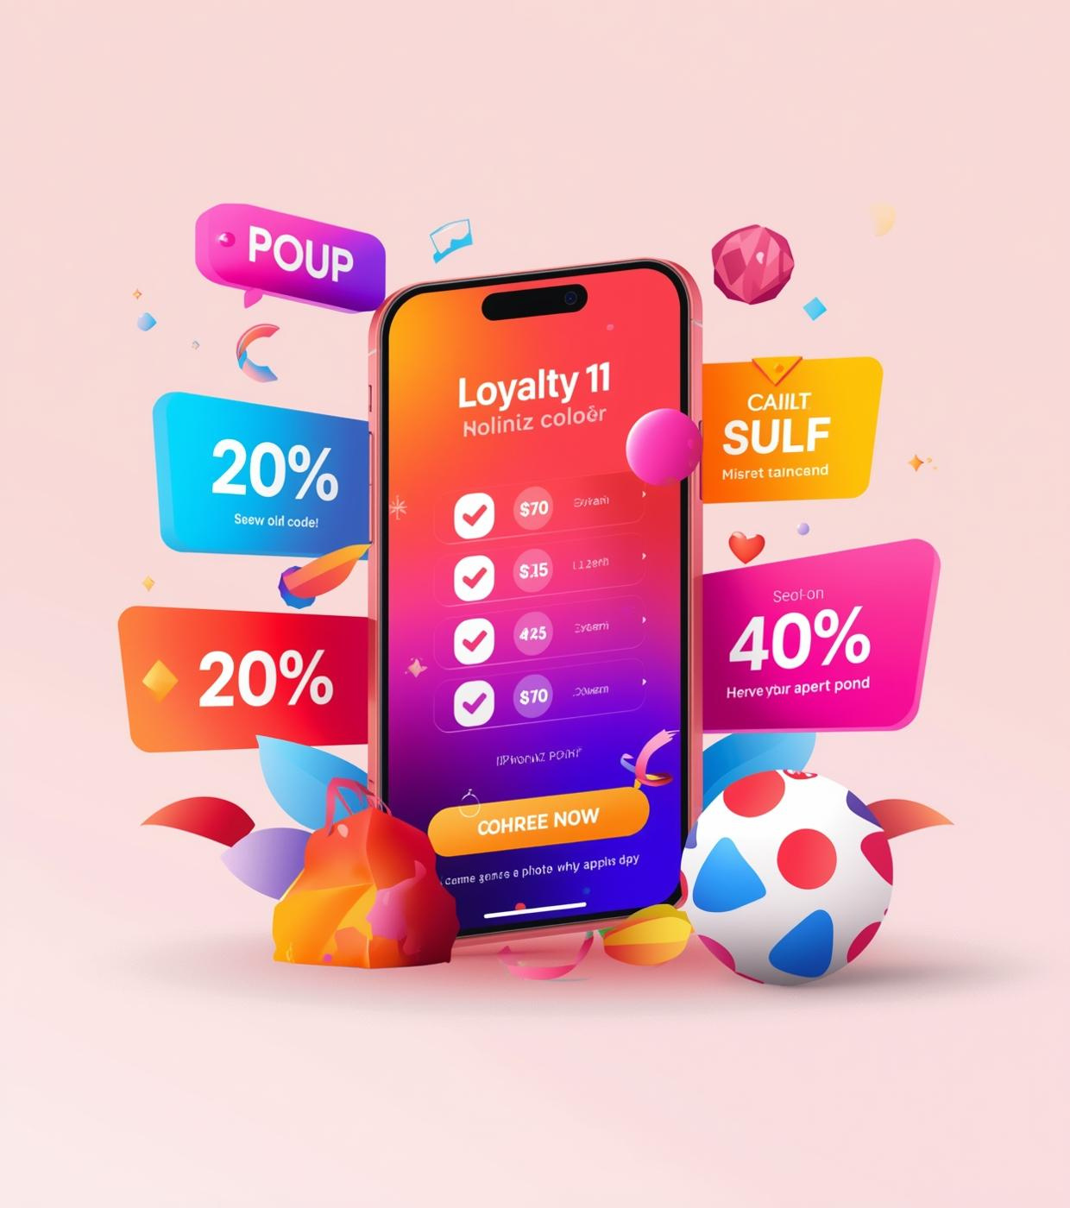
Promotions & Rewards
Discover the benefits of our loyalty program designed to reward you for every order. Earn points with each purchase and unlock exclusive offers, making your Zayton experience even more enjoyable and rewarding.

Slide 9
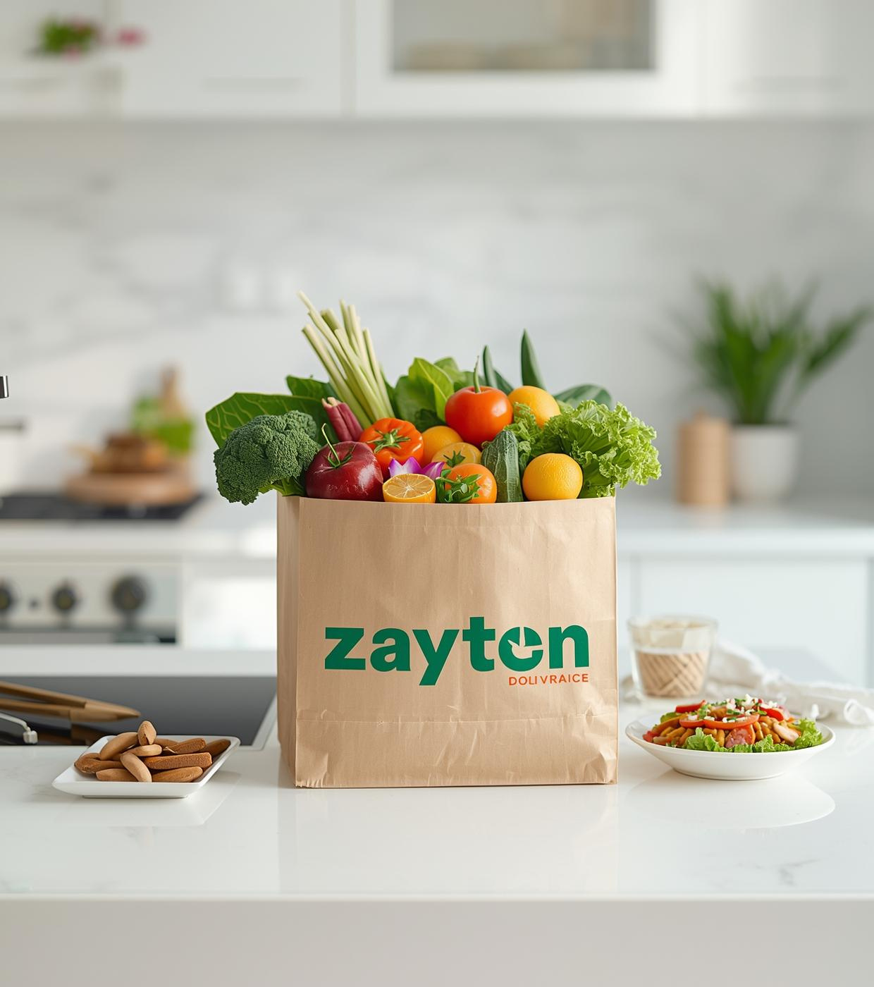
Thank You
Experience Zayton Today – Download on the iOS App Store
Email
hello@reallygreatsite.com
Phone Number
123-456-7890
Website
reallygreatsite.com

